Slide 1


File System API and Disk I/O
SE3331-1 (2024 Fall)
IPADS, Shanghai Jiao Tong University
https://www.sjtu.edu.cn

Slide 2
Review: Large-scale websites on distributed systems
While distributed systems are built from components on a single node
File system runtimes, etc.
Caching server
Caching server
Caching server
…
Caching
Caching
Caching
Distributed caching
Database server
Database server
CDN
Users
Application #1
generate the page
Database
user, price
…
Database
user, price
Application server
Distributed database
Internet
Load
Balance
Application #2
add the order
File server
File server
File server
File:
image
File:
image
…
File:
image
Application server
…
…
Message queue
Distributed file system

Slide 3
Review: Large-scale websites on distributed systems
While distributed systems are built from components on a single node
File system runtimes, etc.
Caching server
Caching server
Caching server
…
Caching
Caching
Caching
Distributed caching
Database server
Database server
CDN
Users
Application #1
generate the page
Database
user, price
…
Database
user, price
Application server
Distributed database
Internet
Load
Balance
Application #2
add the order
File server
File server
File server
File:
image
File:
image
…
File:
image
Application server
…
…
Message queue
Distributed file system

Slide 4
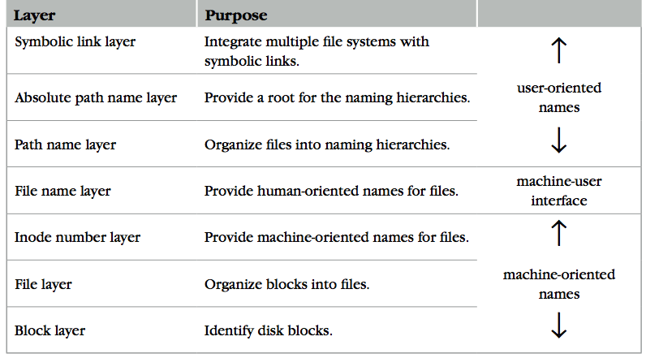
Review: The Naming Layers of the UNIX FS (version 6)
Notes:
TODO: redraw

Slide 5
Review: inode for Larger Files
File
(inode)
Block num
Disk
Block
block
indirect block
double indirect block
triple indirect block
Data
Data
Data
Data
an inode
Data
Data
Notes:
with a 512 byte block size, and 4 byte block pointers, each indirect block can consist of 128 (512 / 4) pointers.
For one double indirect block: (128*128*512) / (1024*1024)
页表的indirection vs. block indirection

Slide 6
Review: L4: File Name Layer
File
name
Inode num
File
(inode)
Block num
Disk
Block
File name
Hide metadata of file management
Files and I/O devices
Mapping
Mapping table is saved in directory
Default context: current working directory
Context reference is an inode number
Question: where can we store the directory?
Method: the current working directory is also a file
struct inode
integer block_nums[N]
integer size
integer type
Overview of a directory inode content
File name | inode num
helloworld.txt | 12
cse2021.md | 73
procedure name_to_inode(string filename, integer dir)-> integer
return LOOKUP(dir, filename)

Slide 7
Directly Dump a Directory
$ ls -ai temp
7536909 . 7530417 .. 7536939 a 7536940 b 7536941 c 7536942 d
$ echo “obase=16;7536909;7530417;7536939;7536940;7536941;7536942" | bc
73010D 72E7B1 73012B 73012C 73012D 73012E
$ sudo /sbin/debugfs /dev/sda1
debugfs 1.43.4 (31-Jan-2017)
debugfs: dump temp temp.out
debugfs: quit
$ xxd temp.out
0000000: 0d01 7300 0c00 0102 2e00 0000 b1e7 7200 ..s...........r.
0000010: 0c00 0202 2e2e 0000 2b01 7300 0c00 0101 ........+.s.....
0000020: 6100 0000 2c01 7300 0c00 0101 6200 0000 a...,.s.....b...
0000030: 2d01 7300 0c00 0101 6300 0000 2e01 7300 -.s.....c.....s.
0000040: c40f 0101 6400 0000 0000 0000 0000 0000 ....d...........
0000050: ...
Notes:
-i: print inode number
-a including all files, including the hidden one

Slide 8
Directly Dump a Directory
0d01 7300 0c00 0102 2e00 0000
b1e7 7200 0c00 0202 2e2e 0000
2b01 7300 0c00 0101 6100 0000
2c01 7300 0c00 0101 6200 0000
2d01 7300 0c00 0101 6300 0000
2e01 7300 c40f 0101 6400 0000
struct ext4_dir_entry {
uint32_t inode_number;
uint16_t dir_entry_length;
uint8_t file_name_length;
uint8_t file_type;
char name[EXT4_NAME_LEN];
}
0d01 7300 0c00 0102 2e00 0000
File Type
0x0: Unknown
0x1: Regular file
0x2: Directory
0x3: Character device file
0x4: Block device file
0x5: FIFO
0x6: Socket
0x7: Symbolic link
0d01 7300: inode number
0c00: entry length is 12 bytes
01: file name length is 1 byte
01: file type is regular file
2e00 0000: file name (2e -> ".")
Notes:
The ASCII character for 0x2E is the period or dot (.).

Slide 9
L6: Absolute Path Name Layer
Absolute path
File
name
Inode num
File
(inode)
Block num
Disk
Block
Path name
HOME directory
Every user has a default working directory (HOME) after login
Problem: no sharing of files between users
Introducing the root directory
A universal context for all users
A well-known name: '/'
Both '/.' and '/..' are linked to '/'
procedure GENERATEPATH_TO_INODE_NUMBER(string path)-> integer
if path[0] = “/” return PATH_TO_INODE_NUMBER(path,1)
else return PATH_TO_INODE_NUMBER(path, wd)

Slide 10
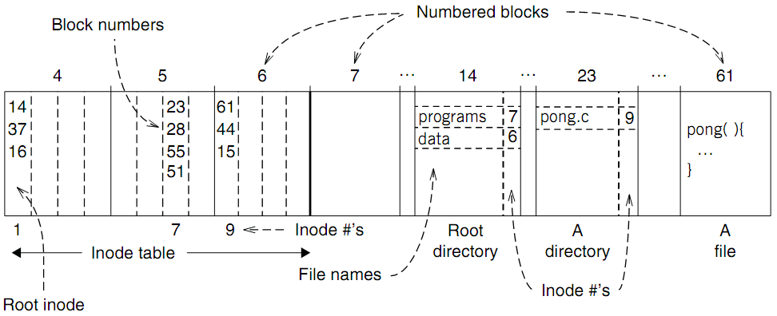
An Example: Find Blocks of "/programs/pong.c"

Slide 11
An Example: Find Blocks of "/programs/pong.c"
'/' root directory: inode is 1

Slide 12
An Example: Find Blocks of "/programs/pong.c"
Find the first directory in '/' by block number

Slide 13
An Example: Find Blocks of "/programs/pong.c"
Find '/programs' by comparing name

Slide 14
An Example: Find Blocks of "/programs/pong.c"
Find '/programs' inode by its inode number 7

Slide 15
An Example: Find Blocks of "/programs/pong.c"
Find the first file in '/programs/'

Slide 16
An Example: Find Blocks of "/programs/pong.c"
Find '/programs/pong.c' by comparing its name

Slide 17
An Example: Find Blocks of "/programs/pong.c"
Find inode of '/programs/pong.c' by the inode number 9

Slide 18
An Example: Find Blocks of "/programs/pong.c"
Find block number of '/programs/pong.c'

Slide 19
An Example: Find Blocks of "/programs/pong.c"
Find data of block 61 by its block number
And data of block 44 & 15

Slide 20
L7: Symbolic Link Layer
Symbolic link
Absolute path
File
name
Inode num
File
(inode)
Block num
Disk
Block
Path name
Name files on other disks
Inode is different on other disks
Supports to attach new disks to the name space
Two options
Make inodes unique across all disks (not good)
Create synonyms for the files on the other disks
Introducing layer 7: soft link (symbolic link)
SYMLINK
Add another type of inode

Slide 21
Directly Dump a Symbolic Link
$ ln -s "/tmp/abc" s-link
$ ls –l s-link
7536945 lrwxrwxrwx 1 xiayubin 8 Sep 20 08:01 s-link -> /tmp/abc
$ readlink s-link
/tmp/abc
$ cat s-link
cat: slink: No such file or directory
$ echo "hello, world" > /tmp/abc
$ cat s-link
hello, world
What does "8" means?
File size

Slide 22
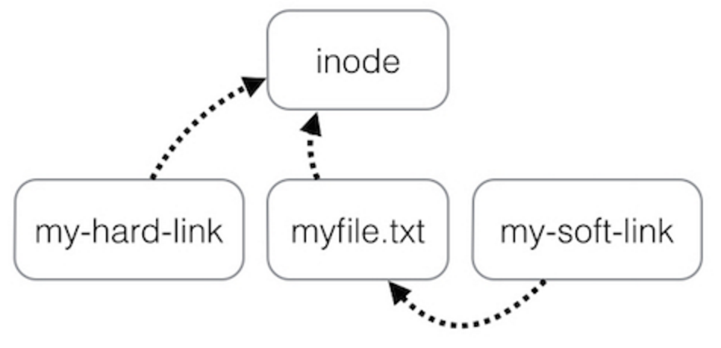
Two Types of Links (Synonyms)
By inode number
By inode number
By file name

Slide 23
Sidebar: Notice the Context Change
Another interesting behavior of soft link
There is a directory: "/Scholarly/programs/www"
The root directory contains a soft link
"/CSE-web" -> "/Scholarly/programs/www"
Run following commands
cd CSE-web
cd ..
What is the current directory? Why?
".." is resolved in a new default context: by bash, not file system

Slide 24
Sidebar: Notice the Context Change
The bash tries to be "human-friendly"
When you cd /into/a/symlink/, the shell remembers the old location (in $OLDPWD) and will use that directory when you cd .. under the assumption that you want to return to the directory you were just in
If you want to use the real .., then you must also use "cd -P .." The -P option says to use the physical directory structure instead of following symbolic links (see also the -P option to the set built-in command); the -L option forces symbolic links to be followed.
$ cd
$ cd a/b/symlink
$ cd -P ..
$ pwd -P
/home/sarnold
$

Slide 25
Summary of File System's 7 Layers
File name is not part of a file
Name is not a part of an inode
Name is data of a directory, and metadata of a file system
One inode can have several names (hard links)
Hard links are equal
If a file has two names, both are links (instead of "a link and a name")
Directory size is small
Only mapping from name to inode number
The term "folder" is somewhat misleading

Slide 26
Implementing the file system API

Slide 27
Implementing the File System API
API
CHDIR, MKDIR
CREAT, LINK, UNLINK, RENAME
SYMLINK
MOUNT, UNMOUNT
OPEN, READ, WRITE, APPEND, CLOSE
SYNC
Implemented as system calls to user applications
Kernel has many sets of function pointers implementing the API
Each set is specific to a FS (chose at mount point)

Slide 28
Sidebar: open() vs. fopen()
Difference between open() and fopen()?
open() returns an fd; fopen() return a FILE*
open() is a system call of OS; fopen() is an API of libc
Questions
Which one can be used on both Windows and Linux?
Which one has better performance?
fopen() provides you with buffering I/O that may turn out to be a lot faster than what you're doing with open()
Notes:
What is the difference between FILE* and fd? Fopen and open?

Slide 29
File Meta-data -- inode
Owner ID
User ID and group ID that own this inode (can be changed by chown)
Types of permission
Owner, group, other
Read, write, execute
Time stamps
Last access (by READ)
Last modification (by WRITE)
Last change of inode (by LINK)
struct inode
integer block_nums[N]
integer size
integer type
integer refcnt
integer userid
integer groupid
integer mode
integer atime
integer mtime
integer ctime
Notes:
There are three more mode bits: setuid, setgid, stick_bit

Slide 30
OPEN a File
Check user's permission
Update last access time
Return a short name for a file
File descriptor (fd)
fd is used by READ, WRITE, CLOSE, etc.

Slide 31
File Descriptor
Each process starts with three default open files
Standard in(stdin): fd = 0, standard out(stdout): fd = 1, standard error(stderr): fd = 2
Can also use fd to name opened devices
Keyboard, display, etc.
Allow a designer not to worry about input/output
Just read from fd 0 and write to fd 1
Each process has its own fd name space
Notes:
What is the different between fd and inode?
More details on device as a file

Slide 32
Why File Descriptor?
Other options
Option-1: OS returns an inode pointer
Option-2: OS returns all the block numbers of the file
Reasons and considerations
Security: user can never access kernel's data structure
Non-bypassability: all file operations are done by the kernel
Aka., complete mediation

Slide 33
File Cursor
File cursor
Keep track of operation position within a file
Can be changed by the SEEK operation
Case-1: Sharing file cursor
Parent passes its fd to its child
In UNIX, a child process inherits all open fds from its parent
Allow both parent and child to share one output file
Case-2: Not sharing file cursor
Two processes open the same file
Cursor

Slide 34
fd_table & file_table
One file_table for the whole system
Records information for opened files
inode num, file cursor, ref_count of opening processes
Children can share the cursor with their parent
One fd_table for each process
Records mapping of fd to index of the file_table

Slide 35
File Cursor Sharing
Note: this refcnt is not the refcnt of inode!
fd_table
file_table
fd
index
index
inode num
file cursor
refcnt
Process A
3
115
115
23
128
1
116
23
240
2
fd
index
Process B
3
116
...
fd
index
C is B's child
3
116
Process A, B and C all open just one file with inode number 23
Process A and B open the same file, not share file cursor
Process B and C share the file cursor

Slide 36
OPEN Implementation
procedure OPEN(string filename, integer flags, integer mod)-> integer
0 inode_number ← PATH_TO_INODE_NUMBER(filename, wd)
if inode_number = FAILURE and flags = O_CREATE then // Create the file?
inode_number ← CREATE(filename, mode) // Yes, create it.
if inode_number = FAILURE then
return FAILURE
inode ← INODE_NUMBER_TO_INODE(inode_number)
if PERMITTED(inode, flags) then // Does this user have the required permissions?
file_index ← INSERT(file_table, inode_number)
fd <- FIND_UNUSED_ENTRY(fd_table) // Find entry in file descriptor table
fd_table[fd] ← file_index // Record file index for file descriptor
return fd // Return fd
else return FAILURE // No, return a failure

Slide 37
READ Implementation
procedure READ(integer fd, character[] &buf, integer n)-> integer
0 file_index ← fd_table[fd]
cursor ← file_table[file_index].cursor
inode ← INODE_NUMBER_TO_INODE(file_table[file_index].inode_number)
m ← MINIMUM(inode.size – cursor, n)
atime of inode ← now()
if m = 0 then return END_OF_FILE
for i from 0 to m – 1 do
b ← INODE_NUMBER_TO_BLOCK(cursor + i, inode_number)
COPY(b, buf, MINIMUM(m-i, BLOCKSIZE)
i ← i + MINIMUM(m – i, BLOCKSIZE)
file_table[file_index].cursor ← cursor + m
return m

Slide 38
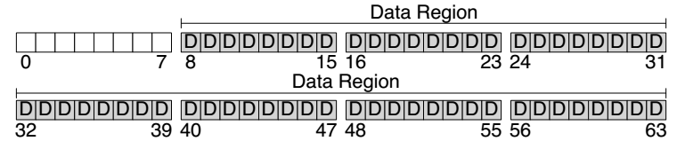
Disk Layout of a Simple File System

Slide 39
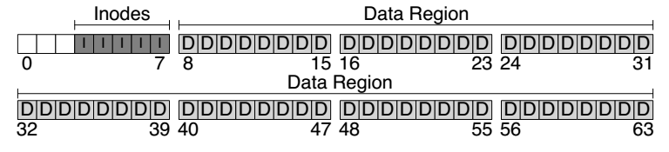
At the Head of a Disk Partition
S
i
d
i: inode free block bitmap
d: data free block bitmap
S: super-block
How many inodes: 80
How many data blocks: 56
Where the inode table begins: block 3
…
A magic number to identify the file system type
The super-block is used when
the file system is mounted

Slide 40
Questions
How many read and write in a OPEN?
How many read and write in a READ?
How many read and write in a CREATION?

Slide 41
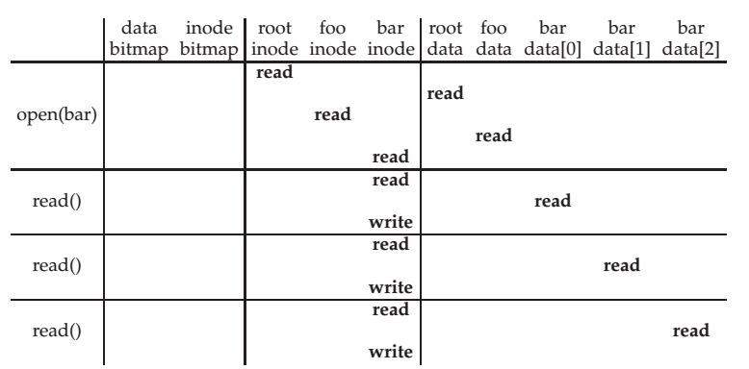
File Open & Read Timeline
open("/foo/bar", O_RDONLY)
Why "write" on bar inode in a read operation? Why no "write" on foo inodes?

Slide 42
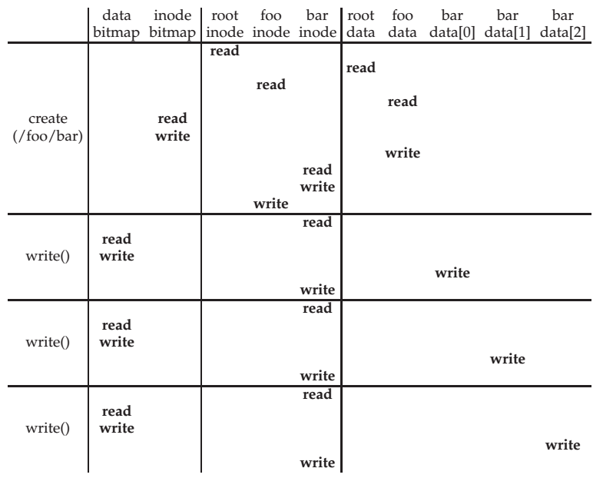
File Creation Timeline

Slide 43
WRITE, APPEND & CLOSE
WRITE is similar to READ
Allocate new block if necessary
Update inode's size and mtime
APPEND
Similar to write, directly write to the end of the file
CLOSE
Free the entry in the fd_table
Decrease the reference counter in file table
Free the entry in file table if counter is 0
Failures in the middle may cause inconsistency!

Slide 44
Questions
When writing, which order is preferred?
Update block bitmap, write new data, update inode (size and pointer)
Update block bitmap, update inode (size and pointer), write new data
Update inode (size and pointer), update block bitmap, write new data

Slide 45
SYNC
Block cache
Cache of recently used disk blocks
Read from disk if cache miss
Delay the writes for batching
Improve performance
Problem: may cause inconsistency if fail before write
SYNC
Ensure all changes to a file have been written to the storage device

Slide 46
Delete after OPEN but before CLOSE
One process has OPENed a file
Another process delete the file
By removing the last name pointing to the file
The reference counter is now 0
The inode is not freed until the first process calls CLOSE
On Windows, it may forbid to delete an opened file

Slide 47
Review: Renaming
1 UNLINK(to_name)
2 LINK(from_name, to_name)
3 UNLINK(from_name)
❌
Text edit usually save editing file in a temp file
Edit in .a.txt.swp, then rename .a.txt.swp to a.txt
What if the computer fails between 1 & 2?
The file to_name will be lost, which will surprise the user
Need atomic action (in later lectures)

Slide 48
Review: Renaming
1 LINK(from_name, to_name)
2 UNLINK(from_name)
Weaker specification without atomic actions
1. Changes the inode # for to_name to the inode # of from_name
2. Removes the directory entry for from_name
If fails between 1 & 2
Must increase reference count of from_name's inode on recovery
If to_name already exists
The to_name file will always exist, even if the machine fails between 1 & 2
Need to revoke the resource on recovery

Slide 49
Rename between different directories
$ ls -il dir1
40978804 -rw-r--r-- 1 xiayubin wheel 6 9 26 08:50 from.txt
$ ls -il dir2
40978827 -rw-r--r-- 1 xiayubin wheel 7 9 26 08:51 to.txt
$ mv dir1/from.txt dir2/to.txt
$ ls dir1
$ ls -il dir2
40978804 -rw-r--r-- 1 xiayubin wheel 6 9 26 08:50 to.txt
inode number

Slide 50
Renaming
1 UNLINK(to.txt)
2 LINK(from.txt, to.txt)
3 UNLINK(from.txt)
1 LINK(from.txt, to.txt)
2 UNLINK(from.txt)
If to.txt exists and fails between 1 & 2
The file to.txt will be lost,
which will surprise the user
If to.txt exists and fails between 1 & 2
It will always exist even if the machine fails between 1 & 2
Must increase reference count of from.txt's inode on recovery

Slide 51
Other file systems (not inode)

Slide 52
Other Choices instead of inode
Method-1: use continue blocks
Re-allocate if the file expands
E.g., data in memory
Why not?
Method-2: use a linked list
Each block links to its next block
Use special one as EOF (End of File)
E.g., FAT32
Why not?
How to integrate different FS?
vnode (will discuss later)
Interface is similar with inode

Slide 53
FAT (File Allocation Table) File System
File is a collection of disk blocks
FAT is a linked list 1-1 with blocks
File Number is index of root of block list for the file
File offset (o = < B, x > )
Follow list to get block #
Unused blocks ⬄ FAT free list
FAT
Disk Blocks
file number
0:
0:
31:
File 31, Block 0
File 31, Block 1
free
File 31, Block 2
N-1:
N-1:
memory

Slide 54
FAT Properties
File is a collection of disk blocks
FAT is a linked list 1-1 with blocks
File Number is index of root of block list for the file
File offset (o = < B, x > )
Follow list to get block #
Unused blocks ⬄ FAT free list
Ex: file_write(31, < 3, y >)
Grab blocks from free list
Linking them into file
FAT
Disk Blocks
file number
0:
0:
31:
File 31, Block 0
File 31, Block 1
File 31, Block 3
free
File 31, Block 2
N-1:
N-1:
memory

Slide 55
FAT File System
File allocation table (FAT)
Organize files as linked lists
No inode
File metadata: name & size
Metadata are saved in dirs

Slide 56
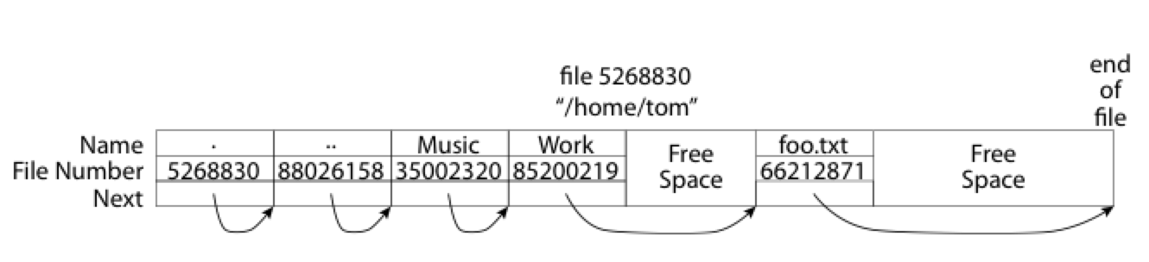
What about the Directory in FAT?
Directory: essentially a file containing <file_name: file_number> mappings
Free space for new entries
File attributes (metadata) are kept in directory
Each directory is a linked list of entries
Question: Where to find root directory ( "/" )?
Root dir at sector 0

Slide 57
Question: inode vs. FAT
What are the differences between inode and FAT?
Support hard link? Soft link?

Slide 58
System Complexity

Slide 59
Problem Types
Emergent properties (surprise!)
The properties that are not considered at design time
Propagation of effects (butterfly effort)
Small change -> big effect
Incommensurate scaling (growing pains)
Design for small model may not scale
Trade-offs (waterbed effect)
You cannot sell the cow and drink the milk

Slide 60
1. Emergent Properties
Features
No evident in the individual components of a system
But show up when combining those components
Might also be called surprises
An unalterable fact of life: some things turn up only when a system is built

Slide 61
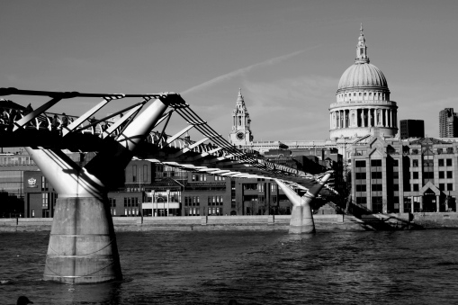
1. Emergent Properties
The Millennium Bridge
For pedestrians over the River Thames in London
Pedestrians synchronize their footsteps when the bridge sways, causing it to sway even more
It had to be closed after only a few days

Slide 62
Emergent Property Example: Ethernet
All computers share single cable
Goal is reliable delivery
Listen while sending to detect collisions
If two nodes sends data at the same time, then both cancel and wait for a random time
00011011
1101100
A
Max length: 1km
B

Slide 63
Does Collision Detection Work?
00011011
1101100
A
Max length: 1km
B
What if A finishes sending before data from B arrives?
1km at 60% speed of light = 5 ms (microseconds)
Original Ethernet Spec: 3 Mbit/sec
A can send 15 bits before bit 1 arrives at B
A must keep sending for 2*5 ms (to detect collision when first bit from B arrives)
Minimum packet size is 5*2*3 = 30 bits
The default header is 5 bytes (40 bits), so no problem for now

Slide 64
3 Mbit/s -> 10 Mbit/s, What will Happen?
First Ethernet standard: 10 Mbit/s, 2.5 km wire
Must send for 2*12.5 µseconds = 250 bits @ 10 Mb/s
Header was 14 bytes
Needed to pad packets to at least 250 bits (~32 bytes)
Emergent property: Minimum packet size!
The 250-bit minimum packet size is a surprise

Slide 65
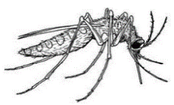

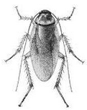



2. Propagation of Effects ^{[Cole'69]}
WHO: tried control malaria in North Borneo
Sprayed villages with DDT
Wiped out mosquitoes, but ….
Roaches collected DDT in tissue
Lizards ate roaches and became slower
Easy target for cats
Cats didn't deal with DDT well and died
Forest rats moved into villages
Rats carried the bacillus for the plague
WHO just replaced malaria with the plague

Slide 66
Example: No Small Changes
Phone network features
CF: Call Forwarding
CNDB: Call Number Delivery Blocking
The caller's number should be hidden
ACB: Automatic Call Back
IB: Itemized Billing
CF
CF
A
C
??
CNDB
ACB + IB
A calls B, B is busy
Once B is done, B automatically calls A
A's (caller) number appears on B's bill
A
B

Slide 67
3. Incommensurate Scaling
As a system increases in size or speed, not all parts of it follow the same scaling rules
So things stop working
The mathematical description
Different parts of the system exhibit different orders of growth

Slide 68
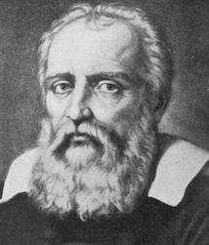
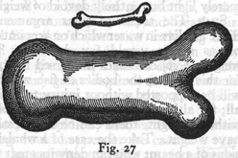
3. Incommensurate Scaling
Galileo in 1638
To illustrate briefly, I have sketched a bone whose natural length has been increased three times and whose thickness has been multiplied until, for a correspondingly large animal, it would perform the same function which the small bone performs for its small animal.
From the figures here shown you can see how out of pro- portion the enlarged bone appears.
Galileo

Slide 69
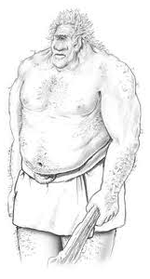
3. Incommensurate Scaling
Galileo in 1638
Clearly then if one wishes to maintain in a great giant the same proportion of limb as that found in an ordinary man he must either find a harder and stronger material for making the bones, or he must admit a diminution of strength in comparison with men of medium stature; for if his height be increased inordinately he will fall and be crushed under his own weight.

Slide 70
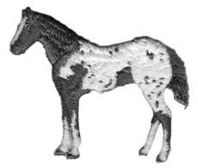

3. Incommensurate Scaling
Galileo in 1638
Whereas, if the size of a body be diminished, the strength of that body is not diminished in the same proportion; indeed the smaller the body the greater its relative strength. Thus a small dog could probably carry on his back two or three dogs of his own size; but I believe that a horse could not carry even one of his own size.

Slide 71
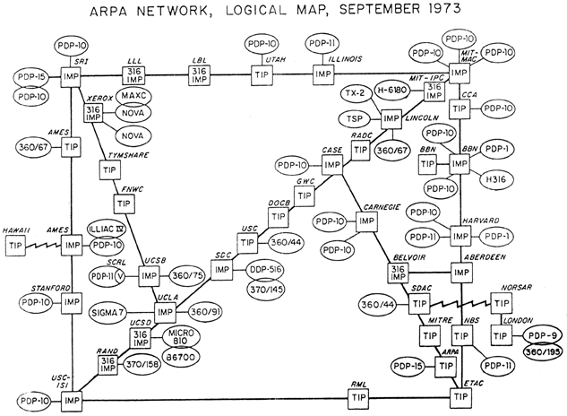
3. Incommensurate Scaling

Slide 72
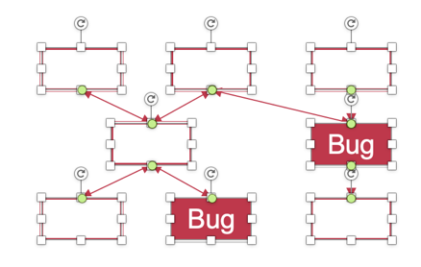
Example: Scaling Figures in PPT
Bug
Bug
Original
A mess after scaling

Slide 73
Example: Scaling the Internet
Size routing tables (for shortest paths): O(n²)
Hierarchical routing on network numbers
Address: 16-bit network number and 16-bit host number
Limited networks (2¹⁶)
Solutions:
NAT (Network Address Translators) and IPv6

Slide 74
4. Trade-offs
General models
Limited amount of goodness
Maximize the goodness
Avoid wasting
Allocate where helps most
Waterbed effect
Pushing down on a problem at one point
Causes another problem to pop up somewhere else

Slide 75
4. Trade-offs
Binary classification
We wish to classify a set of things into two categories
Based on presence or absence of some property
But we lack a direct measure of that property
So we identify some indirect measure instead
Known as a proxy

Slide 76
4. Trade-offs
Binary classification (Cont.)
Occasionally this scheme misclassifies something
By adjusting parameters of the proxy
The designer may be able to:
reduce one class of mistakes
but only at the cost of increasing some other class of mistakes

Slide 77
Coping with complexity
M.A.L.H

Slide 78

How to Handle Complexity?
Ideally, the "Constructive Theory"
Allows the designer systematically to
Synthesize a system from its specifications
Make necessary trade-offs with precision
Works in some fields
Communication systems
Linear control systems
Design of bridge and skyscrapers (to a certain extent)

Slide 79
How to Handle?
In Computer Systems
“We find that we were born too soon”
In “Principles of Computer System Design: An Introduction”
The problems
We work almost entirely by analyzing ad hoc examples rather than by synthesizing
So, in place of a well-organized theory, we use case studies

Slide 80
Limit the Levels of Complexity
All systems are indefinitely
The deeper one digs, the more signs of complexity turn up
A computer -> gates -> electrons -> quarks -> …
Abstraction: limits the depth of digging

Slide 81
M.A.L.H
Modularity
Split up system
Consider separately
Abstraction
Interface/Hiding
Avoid propagation of effects
Layering
Gradually build up capabilities
Hierarchy
Reduce connections
Divide-and-conquer

Slide 82
Modularity
Analyze or design the system as a collection of interacting subsystems
Subsystems called modules
"Divide-and-conquer" technique
Modularity is the simplest, most important tool for reducing complexity
Consider interactions among the components within a module without simultaneously thinking about the components that are inside other modules
Notes:
Brain has limitation.

Slide 83
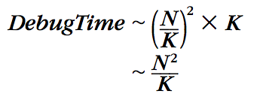
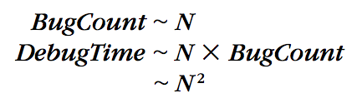
Modularity
Bug
Bug
Bug
Bug
Original System
System with Modularity
Assumptions: consider the number of bugs is proportional to its size, and bugs are randomly distributed

Slide 84
Abstraction
Abstraction
Treat a module based on external specifications, no need for details inside
Principles to divide a module
Follow natural or effective boundaries
Fewer interactions among modules (Chap.4 & 5)
Less propagation of effects

Slide 85
Abstraction
Problem: minimizing interconnections among modules may be defeated
Unintentional or accidental interconnections, arising from implementation errors
Well-meaning design attempts to sneak past modular boundaries
Improve performance
Meet some other requirement
Notes:
E.g., OSDI'12 socket optimization~

Slide 86
Abstraction
Software is particularly subject to this problem
The modular boundaries provided by the separately compiled subprograms are actually somewhat soft
Is easily penetrated by errors in:
using pointer;
filling buffer;
calculating array index;
etc.
Notes:
Java: using get() instead of read field directly.
Buffer overflow attack.

Slide 87
Abstraction
Failure containment
When a module does not meet its abstract interface specifications
Limiting the impact of faults
Well-designed and properly enforced modular abstractions
Control propagation of effects
Modules are the units of fault containment
Notes:
What about data flow?

Slide 88
Layering
Goal: Reduce module interconnections even more
How to do it?
Build a set of mechanisms first (a lower layer)
Use them to create a different complete set of mechanisms (an upper layer)
General rule: A module in one layer only interacts with:
its peers in the same layer, and
modules in the next lower layer / next higher layer

Slide 89
Layering
Application layer
OS layer
Processor & memory layer
Memory cells & gates layer
House:
Inner layer of studs, joist, rafter (shape & strength )
Layer of sheathing and drywall (wind out)
Layer of siding, flooring and roof tiles (watertight)
Cosmetic layer of paint (looks good)
Algebra:
integer, complex number, polynomials, polynomials with polynomial coefficients

Slide 90
Hierarchy
Hierarchy: another module organization
Start with a small group of modules
Assemble them into a stable, self-contained subsystem with well defined interface
Assemble a group of subsystems to a larger subsystem
Example
1 manager leads N employees
1 higher manager leads N lower managers

Slide 91
Hierarchy
There are many striking examples of hierarchy
E.g., microscopic biological systems, assembly of Alexander's empire
Under evolution, such designs have a better chance of survival
Constrains interactions
Permit interaction only among the components of a subsystem
Reduces the number of potential interactions among modules from square-law to linear

Slide 92
Computer systems are different

Slide 93
Computer Systems are Different
Computer systems are the same as all other systems
Certain common problems show up in all complex systems
The techniques that have been devised for coping with complexity are universal
Yet, computer systems are different (sadly)
The complexity is not limited by physical laws
The rate of change of technology is unprecedented

Slide 94
Unbounded Composition
Two properties of computer systems
1. Mostly digital
2. Controlled by software
Both relax the limits on complexity arising from physical laws in other systems

Slide 95
Computer System: Coping with Complexity
M.A.L.H are NOT enough
Hard to choose the right modularity
Hard to choose the right abstraction
Hard to choose the right layer
Hard to choose the right hierarchy

